Slide 1
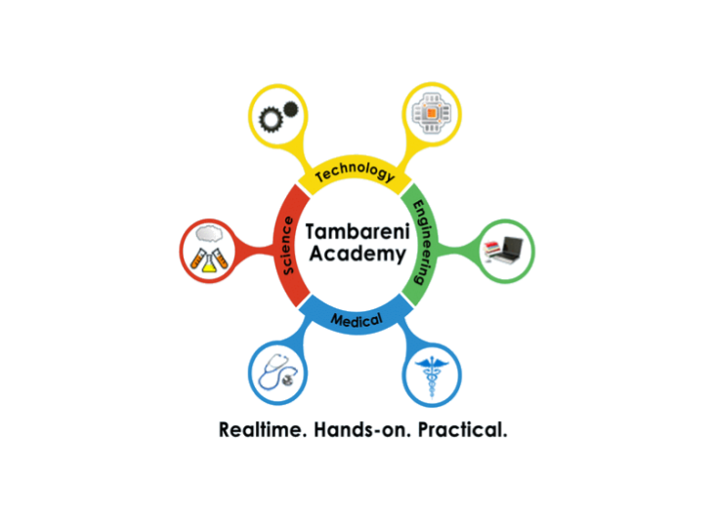

Self-Improvement
Introduction to OOP
By Rishi
TambareniAcademy
www.Tambareni.com

Slide 2
Class:
Imagine you have to create these cubes. And you have to give it to a designer.
Lets see if we can write a design for this Cube Object.
Front = Square
Side = Square
Top = Square
Height = 2 cm
Width = 2 cm
The class can be seen as the blueprint of an object. It describes how an object is created.
TambareniAcademy
www.Tambareni.com

Slide 3


Method:
Do you know how to use toaster?
Input
Method
Processed
Outcome
A method is a block of code with parameters and a return value. It can be called on the object.
TambareniAcademy
www.Tambareni.com

Slide 4

What is an Object?
Apply breaks
Change Gears
Move pedal
Adjust seat
Handle
Break
Pedal
seat
Gears
Wheels
Behavior
Or
Functions
Properties
Or
State
TambareniAcademy
www.Tambareni.com

Slide 5
Object:
Objects are key to understanding object-oriented technology. Look around right now and you'll find many examples of real-world objects: your dog, your desk, your television set, your bicycle.
Software objects are conceptually similar to real-world objects: they too consist of state and related behavior. An object stores its state in fields (variables) and exposes its behavior through methods
TambareniAcademy
www.Tambareni.com

Slide 6

Encapsulation:
Do you know How to use Call button on your cell phone?
Do you understand how this “Call” connects to network and dials the number… basically all logic?
Does that stopped you from using it?
Encapsulation provides the security that keeps data and methods safe from inadvertent changes. It also means hiding data and methods within an Object.
TambareniAcademy
www.Tambareni.com

Slide 7

Polymorphism
Poly – Many ; Morphs – forms
Object-oriented programs are written so that the methods having same name works differently in different context.
RUN
TambareniAcademy
www.Tambareni.com

Slide 8

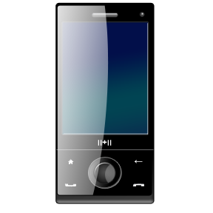
Inheritance
In OOP deriving a new class from existing class, it’s called as Inheritance. New class may have new features in it.
Calls from A to B connected with phone line
Wireless calling. Works outside, send text message
Internet, songs, whatsApp, facebook, GPS and what not
TambareniAcademy
www.Tambareni.com

Slide 9
Thank you.
No question is dumb question.
rishi.h2kinfosys@gmail.com
TambareniAcademy
www.Tambareni.com

